Slide 1
Functions in R & Python
A practical introduction
Lima, Perú
08 October 2022

Slide 2
Content
Introduction to function
Coding vs programming
Benefits of programming
Introduction to Python
Function structure (Python vs R)
Create a source (function dictionary)

Slide 3
Coding vs programming
Instead these words are often used interchangeably, they actually signify two very different things.
Coding | Programming
Translate the requirement logics into a machine-understandable code without worrying about the details | Analyze and conceptualize different aspects of any program and also solutions to any problems that may or may not occur due to the process
Basic knowledge of programming skills without any software tools | Good knowledge of programming skills and good software development tools
Helps to work with simple projects | helps to work with big projects and manage them

Slide 4
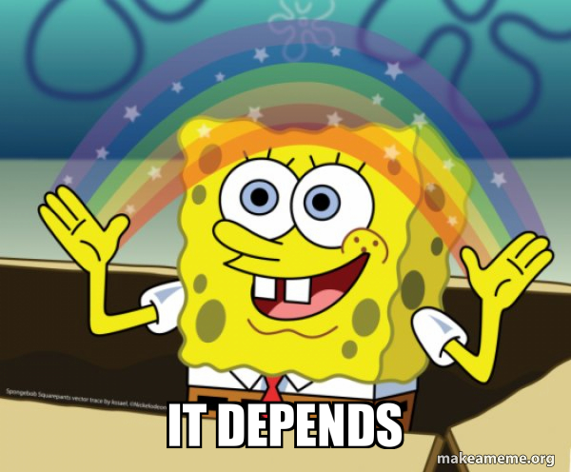
Coding vs programming
So, is it better to learn coding or programming?
Coding: occasional use, general solutions, but also high demand
Programming: frequent use, specific solutions, high demand

Slide 5
Benefits of programming (functions)
Why functions are useful?
Reusability
Modularity
Testing
It can be called multiple times from different spaces. This avoids duplicated code
Divide a complex problem into multiple functions. Better tracking
Less code to test, easier to find bugs. Test a function just once time
Extensibility
Abstraction
Functions reduce the amount of code that has to be written
You don’t need to know how it works, or what other code it’s dependent upon to use it

Slide 6
Imagine the first 10 employees of Google, it’s pretty clear they didn’t have a PHD in computer science, they had programming experience
- Dr. Chuck Severance

Slide 7
Python
What is it?
It’s a high level, dynamic “multiparadigm” (maybe more OOP than others) language. Its core philosophy is readability.
Typing in Python is based on “classes”, which allow programmers to create their own types.
Why it matters?
Because of its readability and broad range of libraries it is one of the more accessible and popular languages for Data Science today, it has also been implemented as an scripting language in multiple softwares which allows interdisciplinary approaches

Slide 8

Function structure
Basic Logic
A function is a block of code which performs a task.
It has a name; which we use to call the function
It has a void; which means it has “no value”
It has an argument; which is the mini-program inside
Photo by Dave Hoefler on Unsplash

Slide 9
C++ and Python
Objective: Return a signal for the execution of a function
// Create a function
void myFunction() {
cout << "I just got executed!";
}
int main() {
myFunction(); // call the function
return 0;
}
// Outputs
"I just got executed!"
#Create a function
def my_function():
print("I just got executed!")
#Call the function
my_function()
#Outputs
"I just got executed!"
C++
Python

Slide 10
R and Python
Objective: Create a function which tells if a number is odd or even
# Create a function
evenodd = function(x)
{
if (x %% 2 == 0)
return(“even!”)
else
return(“odd¡”);
}
# Call the function
print(evenodd)(4)) ;
# Outputs
"even!"
#Create a function
def evenodd(x):
if x%2 == 0:
print("even!")
else:
print("odd¡")
#Call the function
evenodd(4)
#Outputs
“even!”
R
Python

Slide 11
R and Python
Objective: Create a function which tells if a number is odd or even
# Create a function
evenodd = function(x)
{
if (x %% 2 == 0)
return(“even!”)
else
return(“odd¡”);
}
# Call the function
print(evenodd)(4)) ;
# Outputs
"even!"
#Create a function
def evenodd(x):
if x%2 == 0:
print("even!")
else:
print("odd¡")
#Call the function
evenodd(4)
#Outputs
“even!”
R
Python

Slide 12
Python Dive
Objective: Return a signal for the execution of a function
#Create a function
def my_function(fname):
print("Hello from a function called: ", fname)
#Call the function
my_function(“my first function”)
#Outputs
“Hello from a function called: my first function”
#Create a function
def my_function(fname, flastname):
print("Hello from a function called ", fname, flastname)
#Call the function
my_function(“my first function”, “is quite simple”)
#Outputs
“Hello from a function called: my first function is quite simple”
Arguments get a value when called
...And you can have multiple values

Slide 13
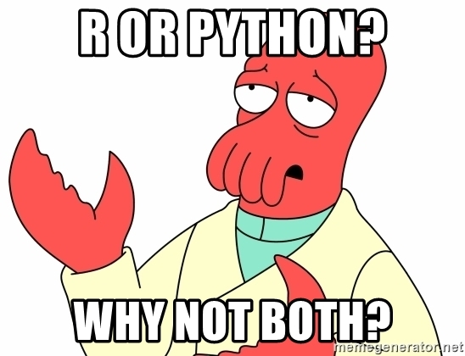
Create a source (function dictionary)
Problem: How automate sum of squares?

Slide 14

The thing with creating Python Source…
And why some people say its and Object Oriented Language

Slide 15

Its impossible to call a function directly from somewhere outside the main file/code
Or at least, it ain’t the easy way…

Slide 16
Python Dive
Objective: Create a function which returns the square of a number
class square:
#x square
def _init_(self, x, y):
self.x = x
self.y= y
def sq(x):
return x*x
#Call function
print(square.sq(4))
#Outputs
16

Slide 17
Functions in R & Python
A guide for a deeper dive
Lima, Perú
15 October 2022

Slide 18
Content
Good Practices in coding
Naming conventions
Indents and spaces
Source/package management
Anaconda vs. Pip (Python)
Introduction to functional programming

Slide 19

Thanks to Stackoverflow (and others) coding is easier everyday…

Slide 20
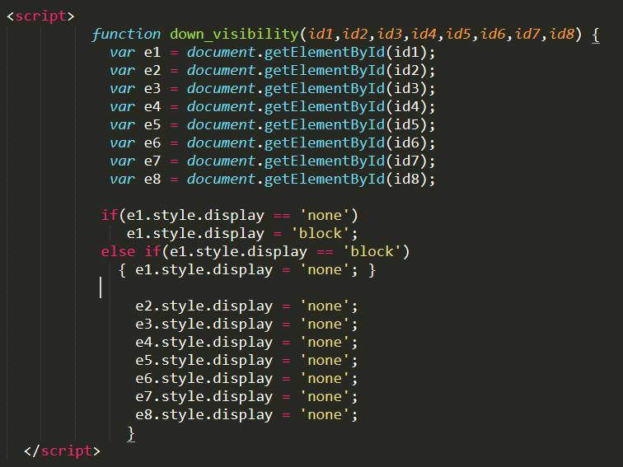
But sometimes answers can lead to ugly solutions
It works! But, can I make it more simple?

Slide 21
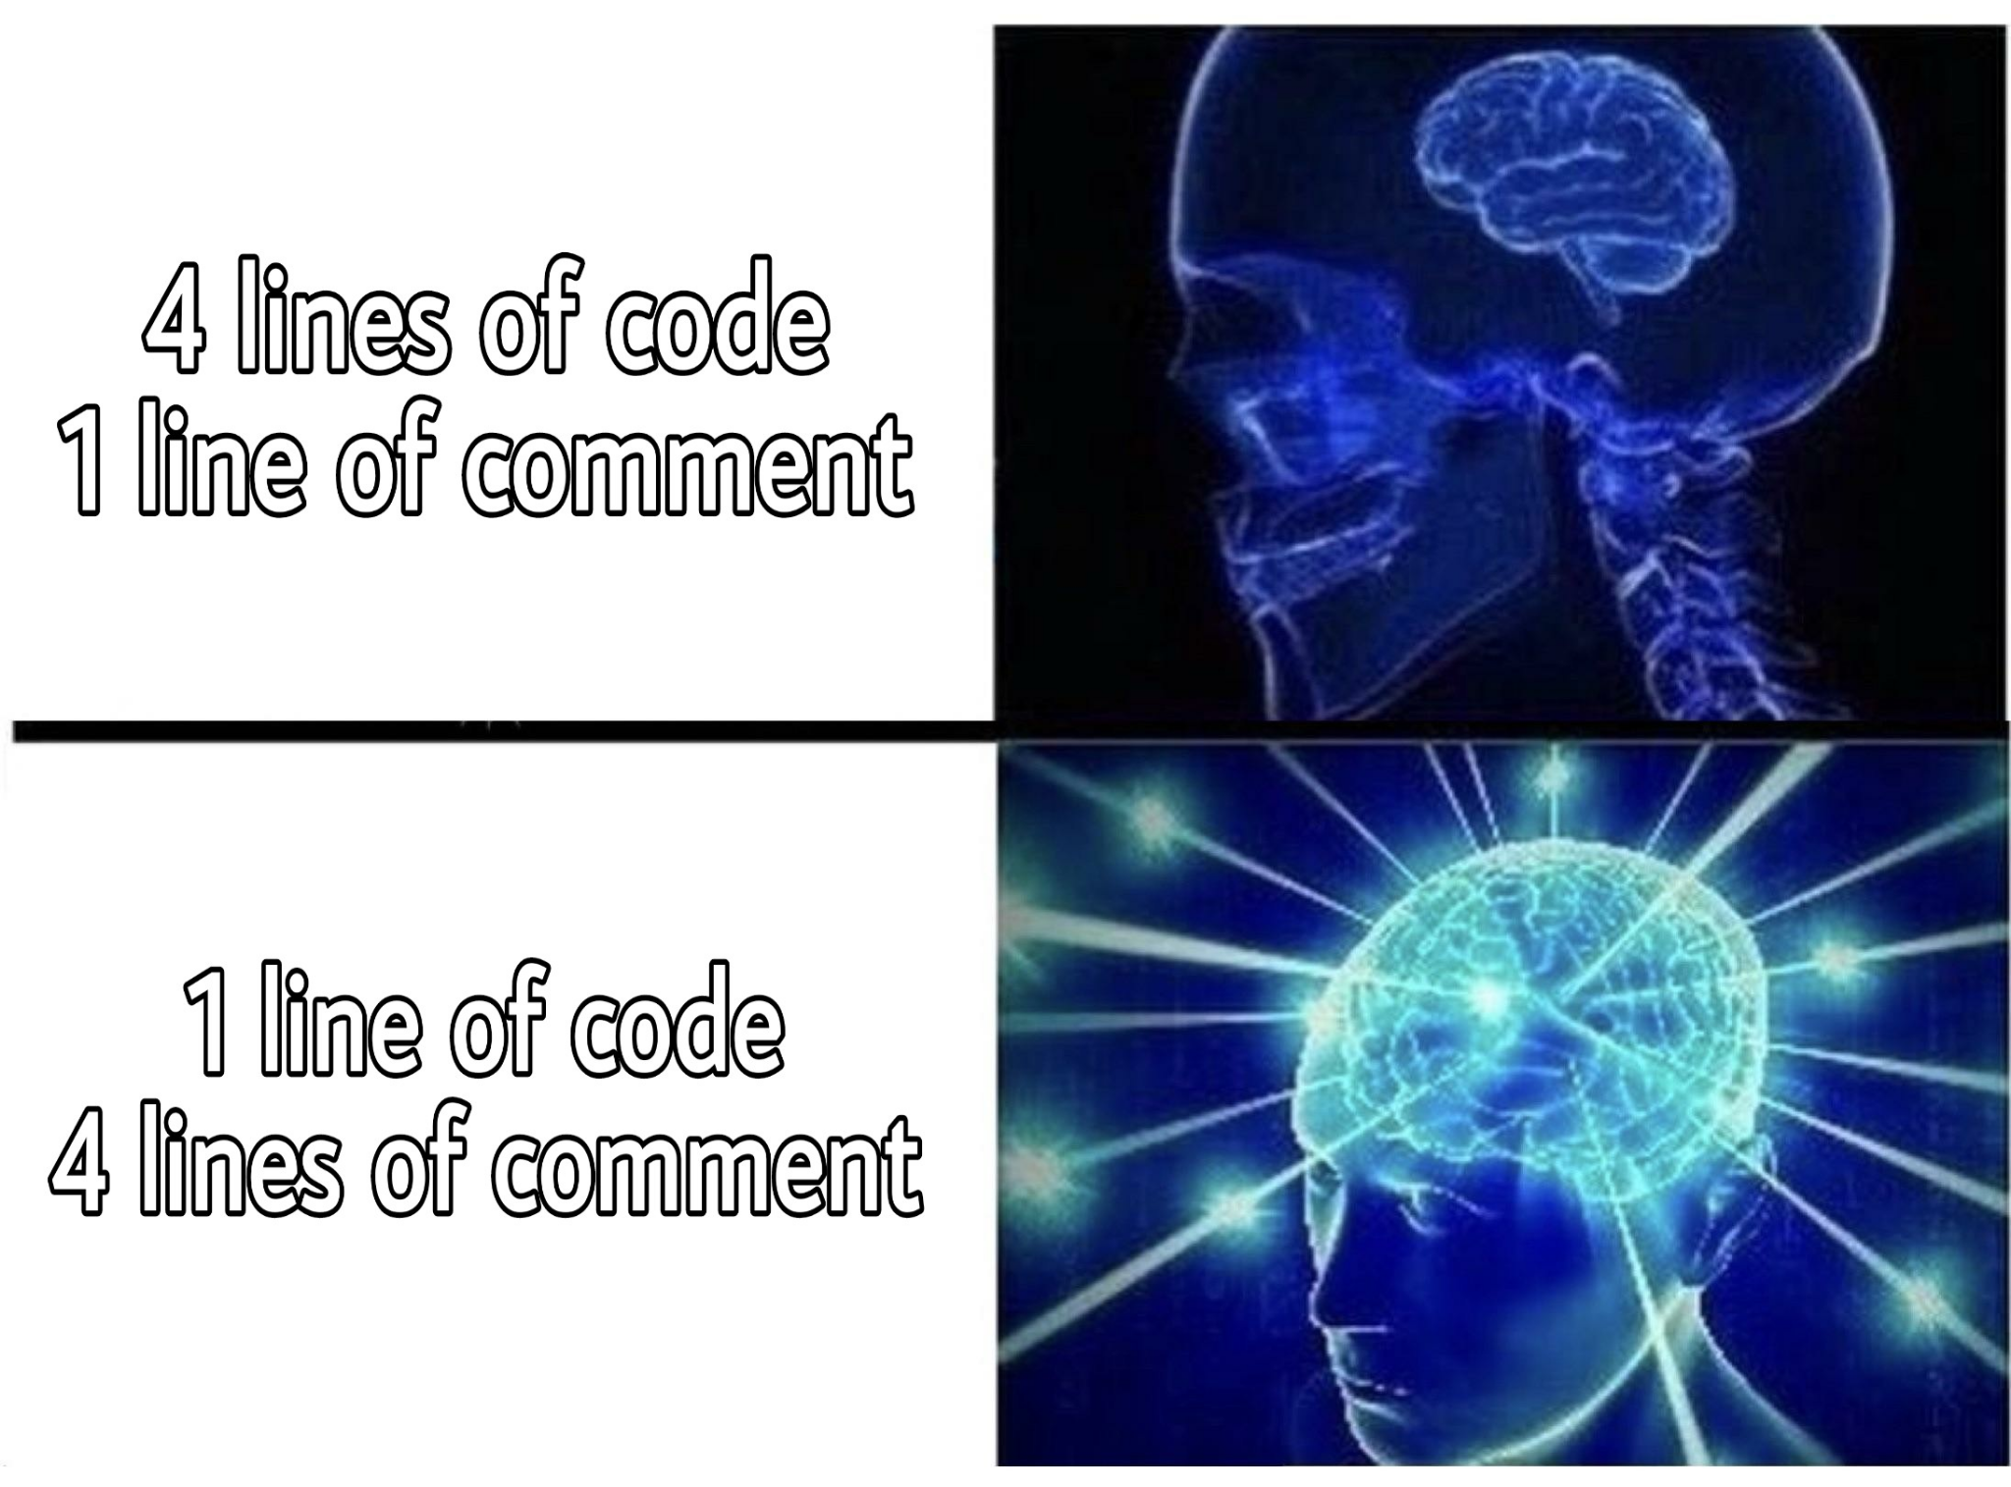
“Beautiful” code it’s inherently subjective
But some standards have become common practice:
Naming should always be sensible and direct to avoid misinterpretations
When working within an organization, we should always ask about naming conventions and nomenclatures
Indents should be used for better readability (mandatory use in Python)
Ockham’s Razor: Avoid Copy+Pasting your own code
Comment always you can

Slide 22
Recycled example
Objective: Create a function which tells if a number is odd or even
#Create a function
def evenodd(x):
if x%2 == 0:
print("even!")
else:
print("odd¡")
#Call the function
evenodd(4)
#Output should be “even!”
sensible naming
Nesting and indentation
Commenting

Slide 23
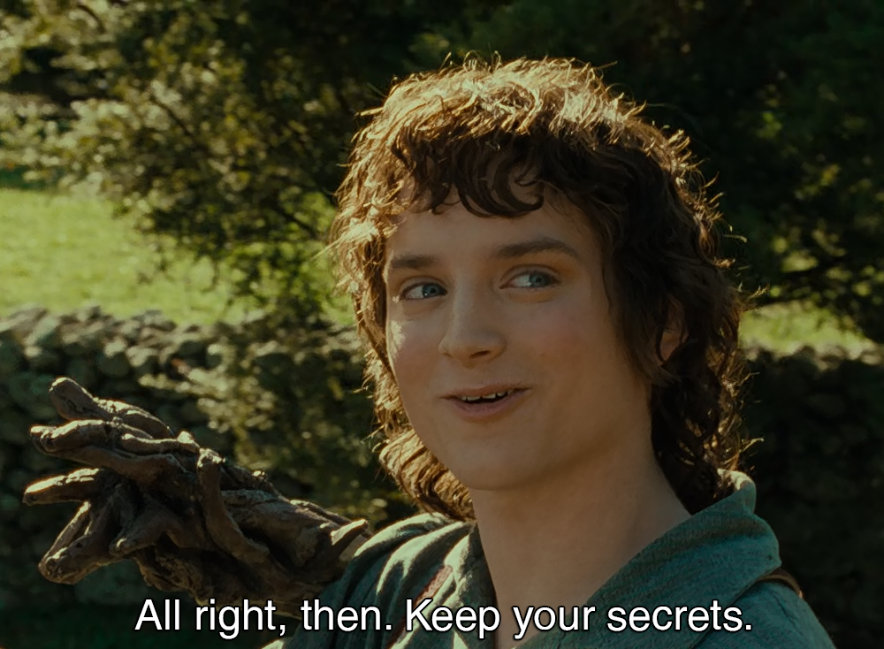
When working on a group…
Practices inside organizations can vary and we should check:
NDA’s and private information that the organization wishes to avoid naming
Previous coding documentation and packages in use
Security limitations and sharing conventions
Nowadays, packages or libraries will (most likely) be used extensively in your projects

Slide 24
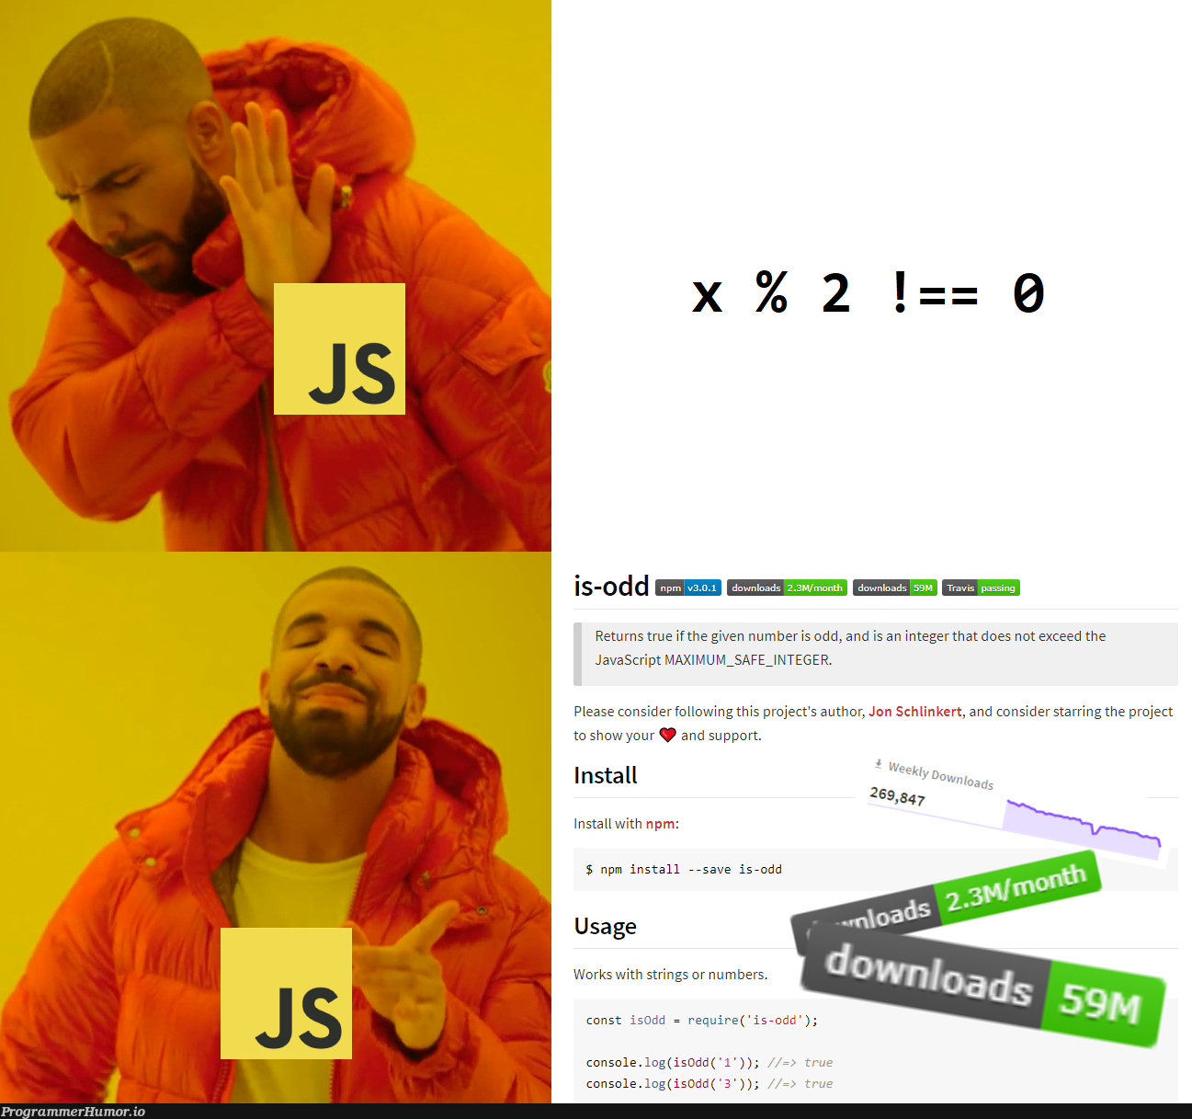
Managing many packages can be tricky…
So we should always keep ours in check
Ockham’s razor: Loose some packages
Update (if not in production)
Manage your sources:
Follow the practices though before, but for your packages
Explore if you need to multiply your sources
Main, per project or per client are some of the options.

Slide 25
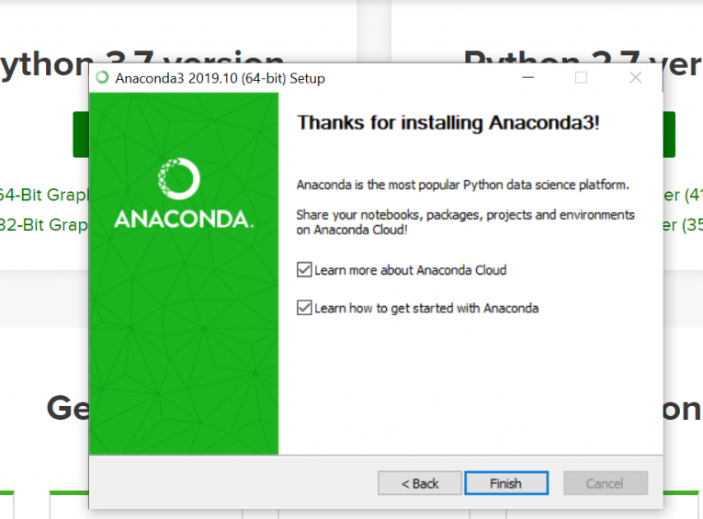
Maybe you have heard about Anaconda
Anaconda is a package manager for Python (and R)
You have to install it before Python or R, or your system might have a hard time
Helps with package management by updating automatically based on performance
Has its own “conda-forge” where people can share their own packages
Conda might be late to some updates that are distributed mainly on pip (ie: psysql)

Slide 26
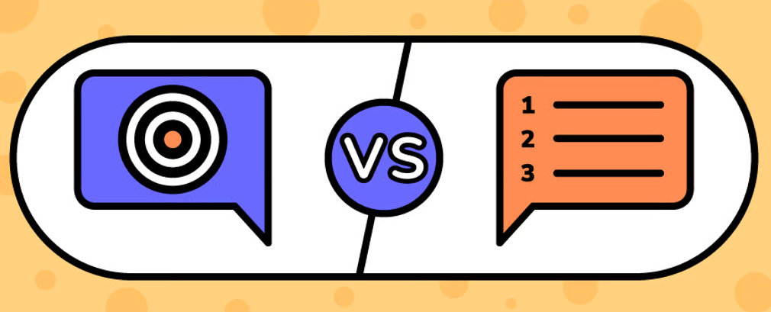
Functional programming
What’s a programming paradigm?
A method to solve a problem
Imperative
Programs specify how it is to be done; direct dictation [JAVA, C, C++]
Declarative
Programs specify what is to be done; desire result [SQL]

Slide 27
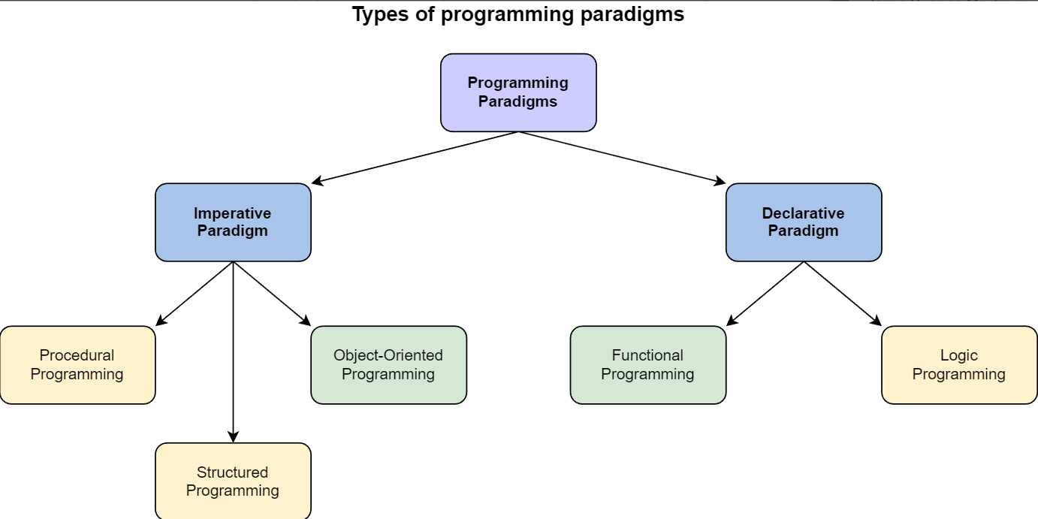
Functional programming
Imperative vs declarative

Slide 28
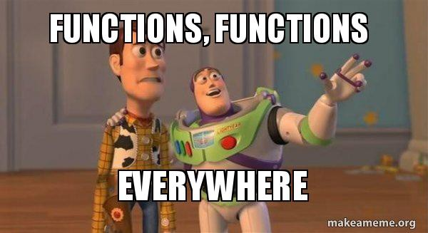
Functional programming
Concepts
Pure functions
Function composition
Recursive functions
High order functions

